Slide 1
Global Shipping Update
Melbourne perspective

Slide 2
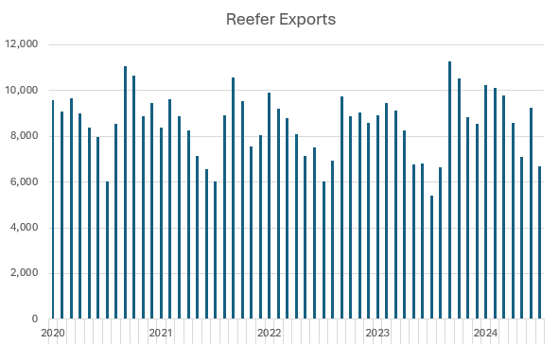
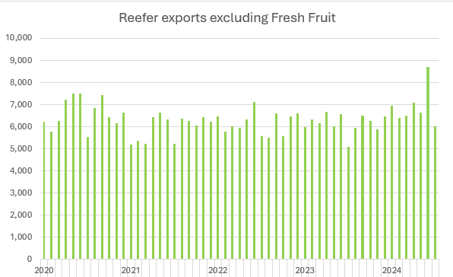
Reefer Export volumes through PoM

Slide 3
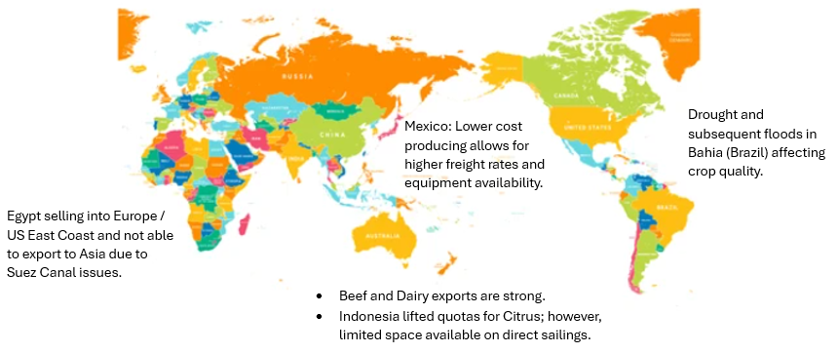
Global market forces
Damietta – Shanghai 68 days
Santos – Shanghai 28 days
(via Panama canal)
Santos – Shanghai 33 -55 days
(via Tanger Med or Singapore)
Durban – Shanghai 14 days
Melbourne – Shanghai 21 days

Slide 4
Container Trade overview
GAC
MSK, CMA, HLC, ONE
NEMO
MSC, CMA
ASAL
COSCO, OOCL
DPW
PATRICK
VICT
MSC CAP (import)
MSC, ZIM
PAD
CMA, MAR
AAA2
COSCO, OOCL, PIL, YML
AAA1
COSCO, OOCL, PIL, YML
Europe
Southeast Asia
China /
Northeast Asia
New Zealand / Pacific / Americas
A3S
OOCL,COSCO, CMA PIL
PANZ
MSK, MSC HLC,CMA
A3N
OOCL, COSCO, CMA, PIL
NEAX
HLC,EMC,HMM, ONE
OC1
MSK, HLC, MSC
A3C
OOCL, COSCO, CMA, PIL
SWIRES
CAT
TSL, YML, HLC, PIL, EMC SINO
PAD
CMA, MAR
ANE
COS, OOCL
NPDL
TTZ
CMA
CA2
TSL, SEAL, YML,PIL
DRAGON
MSK, ONE
PANDA
MSC, ZIM
MSC CAP (export)
MSC, ZIM

Slide 5
Transit Times ex Melbourne
Qingdao | CA2 | 17 |  | Kaohsiung | A3C | 18
 | NEAX | 20 |  |  | CAT | 26
 | DRAGON | 22
 | ZIMPANDA | 22 |  | Yokohama | A3N | 18
 | A3N | 23
 | MSC PANDA | 25 |  | Osaka | A3N | 19
Shanghai | CA2 | 19 |  | Pusan | NEAX | 17
 | MSC PANDA | 20 |  |  | ZIM PANDA | 20
 | A3C | 22 |  |  | A3N | 21
 | NEAX | 23 |  |  | MSC PANDA | 23
 | ZIMPANDA | 25
 | A3N | 26
 | DRAGON | 28
 | CAT | 29
Ningbo | A3C | 25 |  | Pearl River Delta
 | NEAX | 25
 | DRAGON | 25 |  | Shekou | A3S | 18
 | ZIMPANDA | 27 |  |  | CA2 | 24
 | MSC PANDA | 29 |  |  | CAT | 33
 | CAT | 31
 |  |  |  | Yantian | NEAX | 30
Xiamen | A3S | 16 |  |  | DRAGON | 32
 | A3C | 19 |  |  | ZIM PANDA | 32
 |  |  |  |  | MSC PANDA | 33
Hong Kong | A3S | 17
 | ZIMPANDA | 30 |  | NANSHA | MSC PANDA | 23
 | DRAGON | 31 |  |  | CA2 | 26
 | MSC PANDA | 33 |  |  | ZIMPANDA | 30

Slide 6
Preparing for the CT season
Trends:
Consolidation of services
Larger Vessels
Reefer plugs on deck
Terminals
Invest in reefer plugs
DPW 1000 plugs
Patrick 1300 plugs
VICT 1175 plugs
Depots
Invest in generators
Working weekends to pre-trip reefers
Book early and be ready to load just in time!

Slide 7
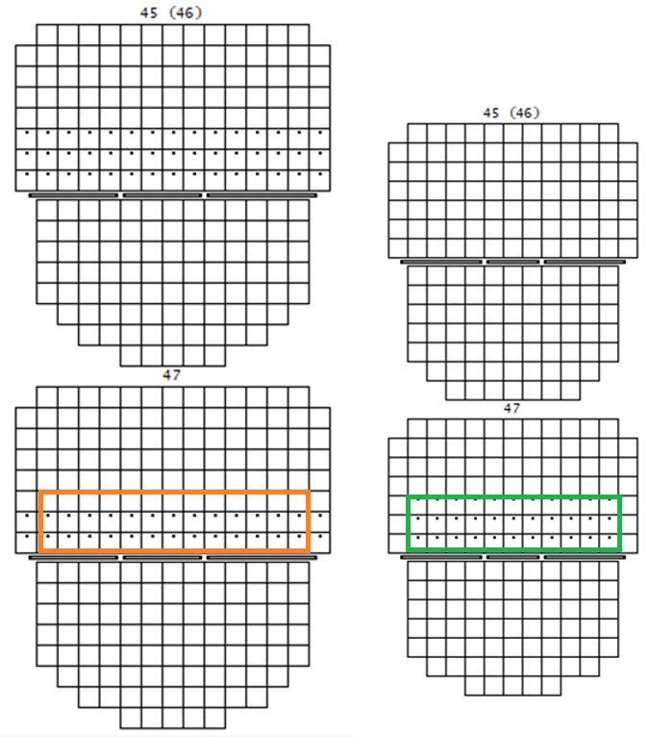
Reefer Plugs onboard
As shipping lines consolidate services, the number of available reefer slots for CT cargo (protected stow on deck) is reducing as a percentage of slots onboard.
Having Melbourne as a second call will allow Melbourne exporters to use vacant slots out of Sydney.
Reefer platforms onboard have added a “third tier” of reefer slots to mitigate some of the loss!

Slide 8
Space and Equipment
Space
direct calls preferred, or complete protocol before transshipment in Asia.
“friendlies” will route hard frozen cargoes via t/ship ports to allow for citrus to go direct to markets in Japan.
Capacity “on deck” is stable, demand for ‘temperature controlled’ freight is increasing.
Vietnam is no longer a direct call on ZIM service, as such, all Vietnam cargo is to be transshipped.
Free Trade Agreements result in increasing quotas to key target markets like Indonesia.
Japan, Indonesia and Thailand have limited direct calls; space will sell out.
Equipment
Southbound repositioning:
Additional transit time ex Europe means lower equipment availability for repositioning.
Competing with more profitable export markets like central America
Reduced sailings impact space for repositioning
Global markets:
Reefer units are limited in supply and shipping lines will ensure that higher paying freight lanes are supplied first.
Price and Availability go hand in hand

Slide 9
Questions?
Thank you for your participation

